Slide 1

VLCC Fleet Utilisation Analysis — Q1–Q2 2025
Prepared by Sam Chung
July 2025

Slide 2
Objective & Dataset
Fleet utilisation is a key cost and revenue driver.
Objective:
Understand VLCC fleet utilisation (Jan-Jun 2025)
Identify vessels and routes significantly below fleet average
Limits: No operational logs or port data — root causes assumed only where supported.
Dataset:
50 vessels, 300 monthly records
Key fields: Vessel_ID, Date, Region, Route, Loaded Days, Ballast Days, Idle Days.
2

Slide 3
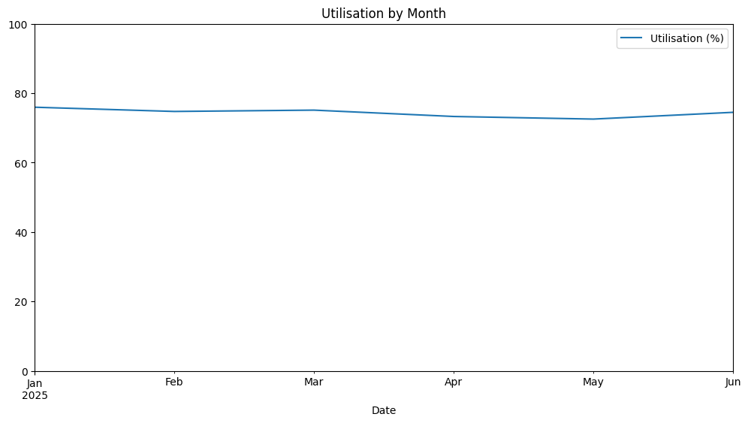
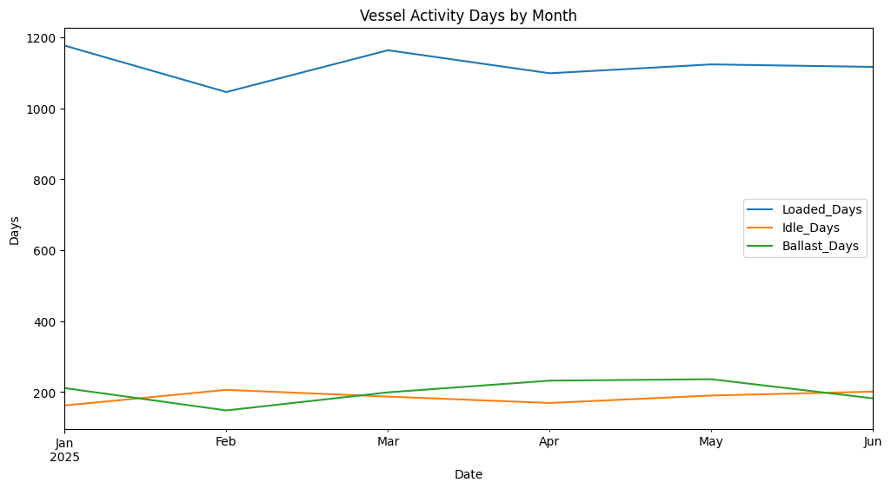
Fleet-Level Trends
Trends:
Stable Utilisation: Consistently high at ~73-76%.
Variation within ~3% range, consistent performance.
Loaded Days: Majority of time spent on loaded voyages.
Idle & Ballast Days: Low but with slight increases in ballast days in Apr-May.
Insights:
Fleet is stable – no major seasonality. Higher ballast in Apr-May suggests suboptimal voyage planning or routing. Further operation data needed to confirm.
3

Slide 4



Region & Route Comparison
Utilisation (%) by Region
Utilisation (%) by Origin
Utilisation (%) by Destination
North Sea is noticeably lower (~71.5%) vs. other regions; indicates scope to investigate causes.
Caribbean & WAF routes show 1-2% lower average utilisation than fleet mean. This suggests room to review voyage patterns or scheduling.
Both US destinations have lowest utilisation – worth investigating reasons (Port logs and scheduling data needed for deeper insight).
4

Slide 5
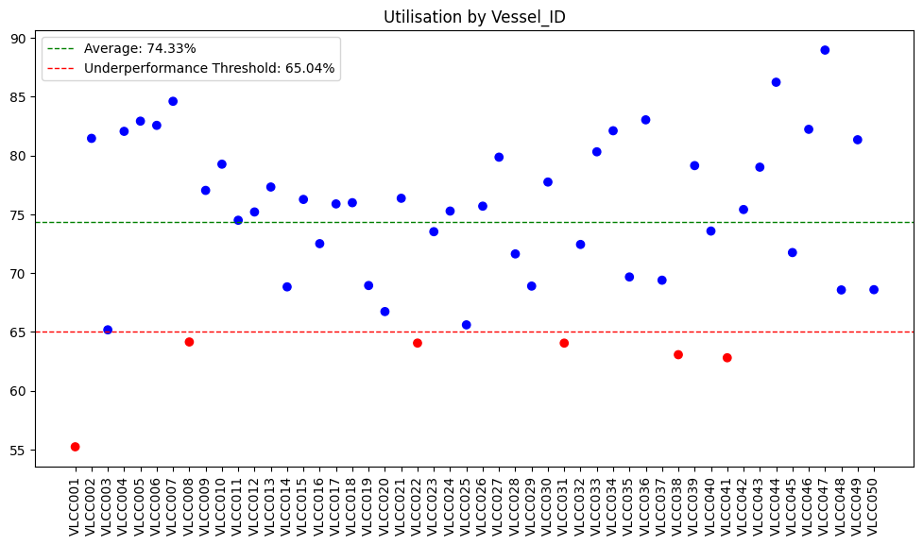
Vessel-Level Outliers
Most vessels cluster around 70–85% utilisation, showing good operational consistency across the fleet.
6 vessels average significantly below fleet mean (more than 12.5% under the mean).
Action Points:
Next step: verify if recurring routing patterns or scheduling gaps explain underperformance.
Recommend monitoring these vessels more closely with daily tracking to spot persistent idle or ballast days.
Investigate top performers and implement strategies to help bring low performers closer to the mean.
VLCC041
62.80%
VLCC008
64.14%
VLCC022
64.05%
VLCC031
64.05%
VLCC001
55.24%
VLCC038
63.06%
5

Slide 6

Recommendations & Next Steps
Key Takeaways
Maintain strong overall fleet efficiency while targeting pockets of underperformance.
Action 1: Use daily tracking to spot prolonged idle/ballast periods for 6 lowest-performing vessels.
Action 2: Review routing patterns on Caribbean & WAF routes to understand if voyage lengths or turnarounds contribute to lower utilisation.
Action 3: Propose integrating port call logs and maintenance data for next analysis to confirm root causes.
N.B. Root cause analysis requires additional data (port logs, maintenance).
✔ Fleet avg. utilization: ~75% — stable ops
✔ North Sea/US routes slightly below avg. — investigate port/route delays
✔ 6 VLCCs underperforming — review maintenance & deployment
6

Slide 7
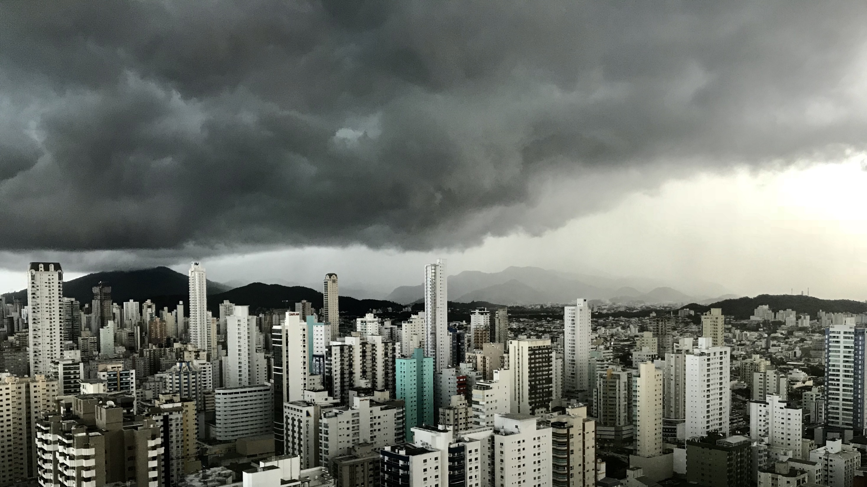
THANK YOU

Slide 8
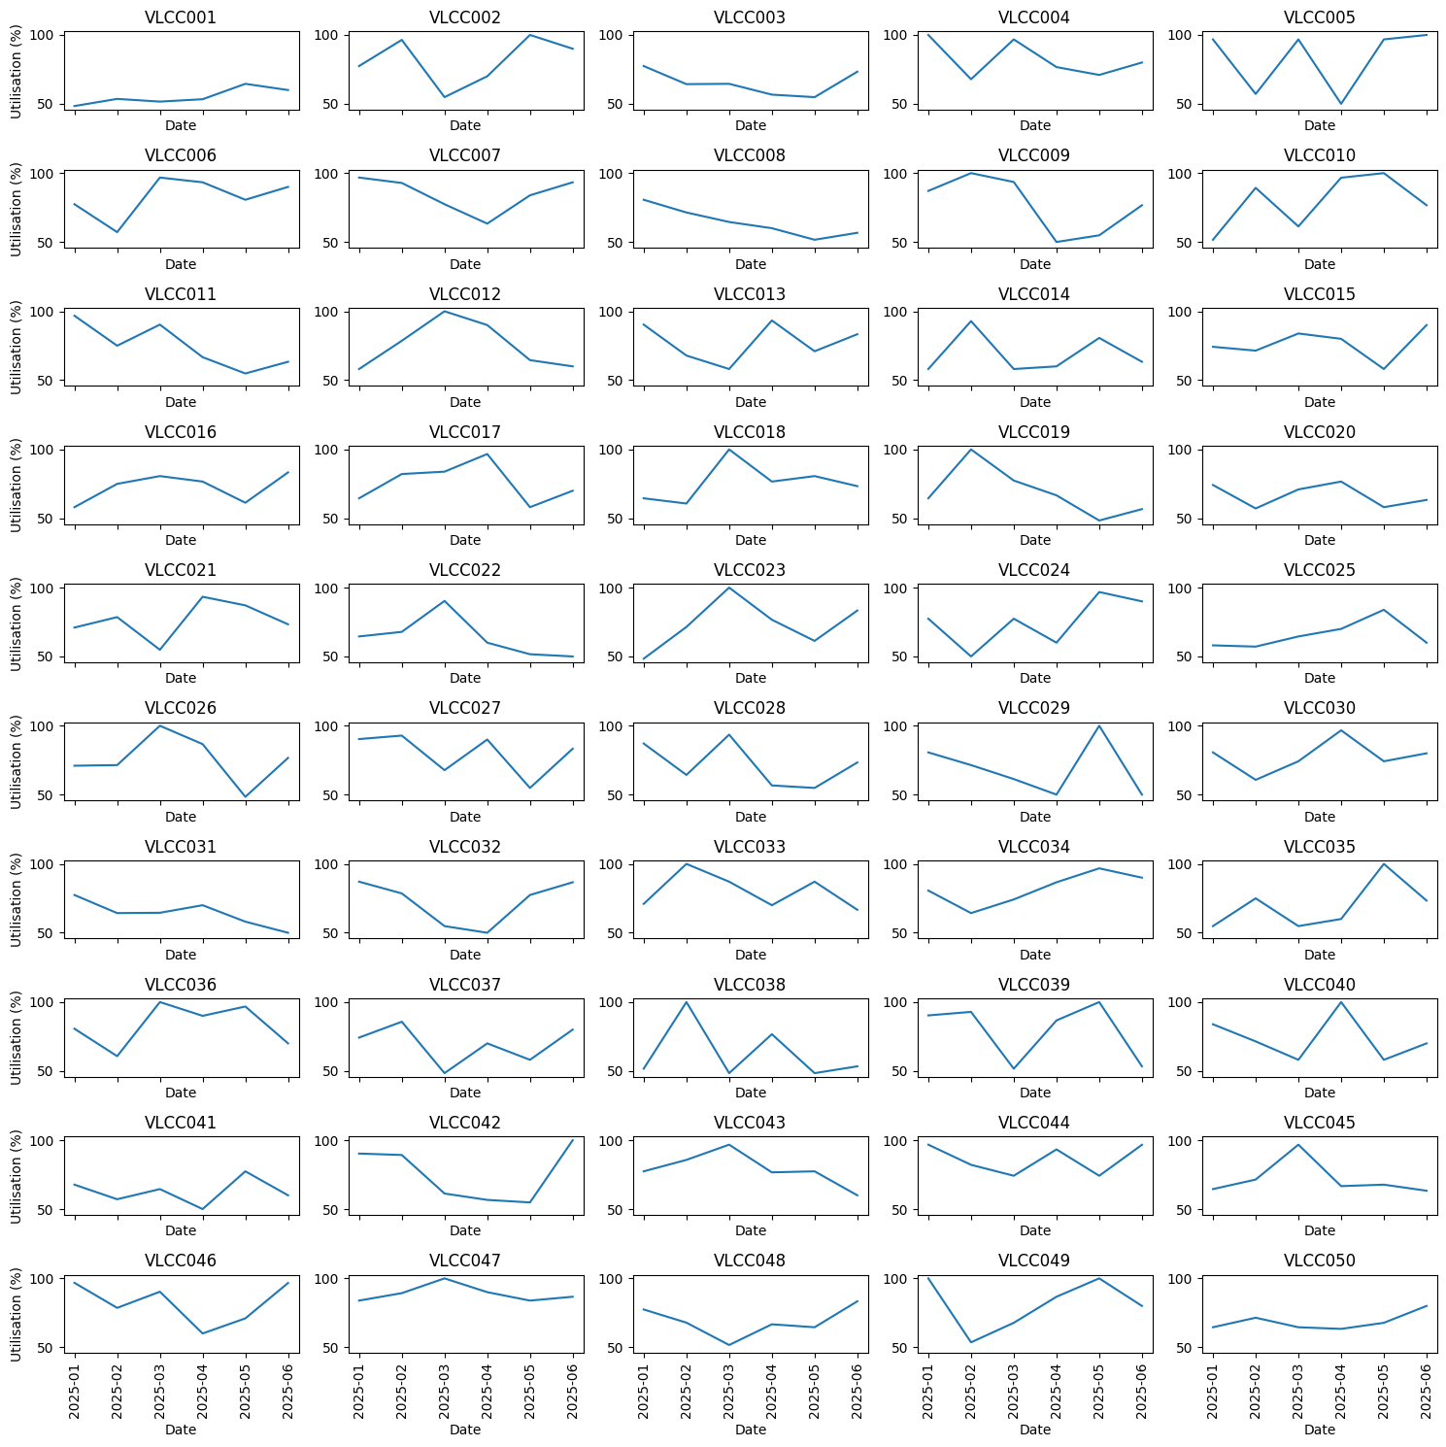
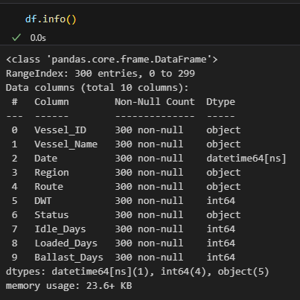
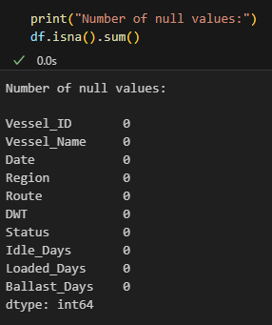

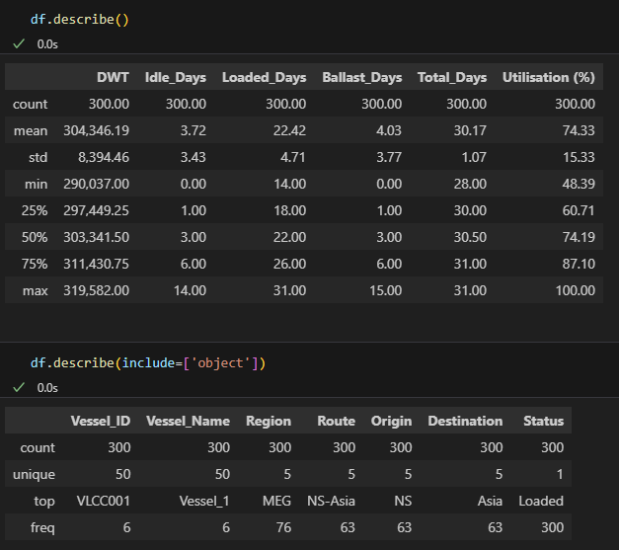
Appendix

